Slide 1
Blockchain-Enabled Distributed DevOps: Enhancing Security, Transparency and Traceability in Software Development
Guide by,
Mrs. NAIMA GEORGE
Assistant Professor
CCSIT, Dr. John Matthai Centre
Presented by,
Ms. DEVIKA SUNILKUMAR
2nd Semester MCA - C1

Slide 2
CONTENTS
Introduction
Preliminaries
Proposed Framework
Discussion
Conclusion and Future Work
References

Slide 3
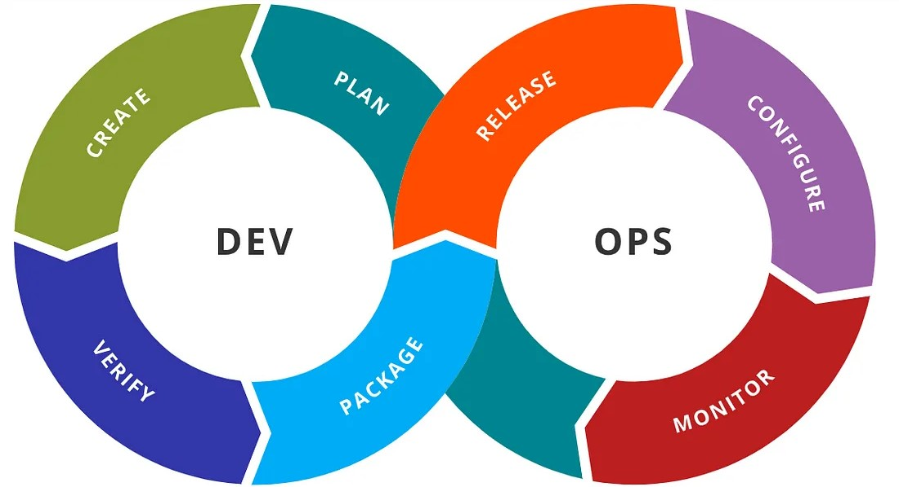
INTRODUCTION
As software development becomes more complex, DevOps integrates development and operations for efficient CI/CD.
Distributed DevOps enables global team collaboration but faces challenges like security, transparency, and traceability, leading to delays and vulnerabilities.
Blockchain technology offers a decentralized, immutable solution to these issues.

Slide 4
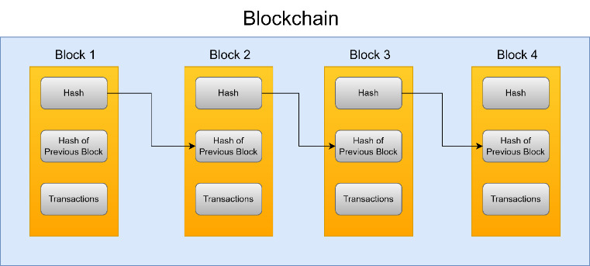
This paper proposes a integrates blockchain into the DevOps pipeline using smart contracts, IPFS, and consensus mechanism to enhance security and reliability.
A framework-based approach was implemented in Python and tested with Spyder IDE and Postman, showing improvements in security, traceability, and transparency.
Future research may explore AI-driven automation in blockchain-enabled DevOps.

Slide 5
PRELIMINARIES

Slide 6
PRELIMINARIES
This section highlights the preliminaries for the proposed framework.
The major components that will be used in this framework will be described in this section including;
IPFS (InterPlanetary File System)
Blockchain and Smart Contracts
Decentralized Applications (DApps)
JENKINS

Slide 7
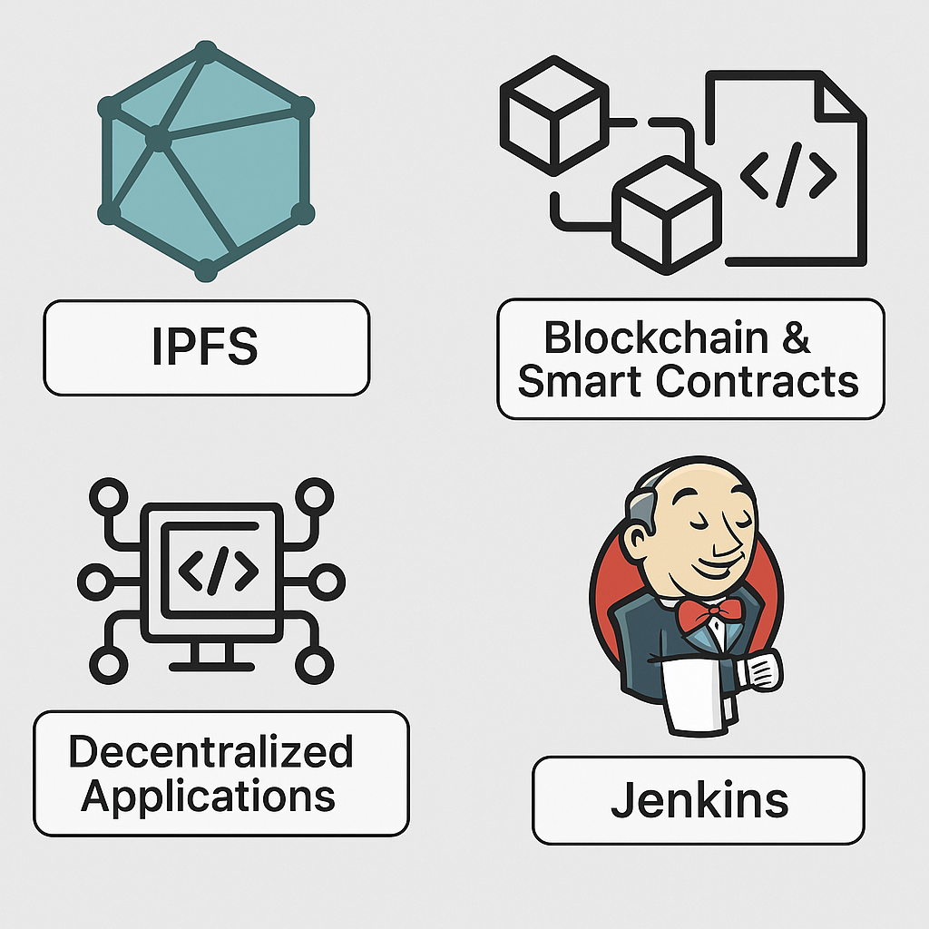
. IPFS (InterPlanetary File System)
IPFS is a content-addressable file system for secure and efficient data storage and sharing.
Its peer-to-peer network ensures data resilience, availability.

Slide 8
Blockchain And Smart Contracts
Blockchain is a secure, transparent, and immutable ledger.
Smart contracts are self-executing codes on the blockchain, allowing trusted, automated transactions without intermediaries.

Slide 9
. Decentralized Applications (DApps)
DApps are open-source apps running on decentralized networks.
They rely on smart contracts for backend logic and function autonomously on blockchain platforms.

Slide 10
JENKINS
An open-source automation tool that automates software build, test, and deployment.
It supports pipeline-as-code and is highly flexible and extensible.

Slide 11
PROPOSED FRAMEWORK

Slide 12
PROPOSED FRAMEWORK
This section presents a framework to improve traceability, security, and trust in CI/CD processes within Distributed DevOps.
It combines Blockchain, DApps, Jenkins, Smart Contracts, and IPFS to enable secure, transparent, and immutable software development across distributed teams.

Slide 13
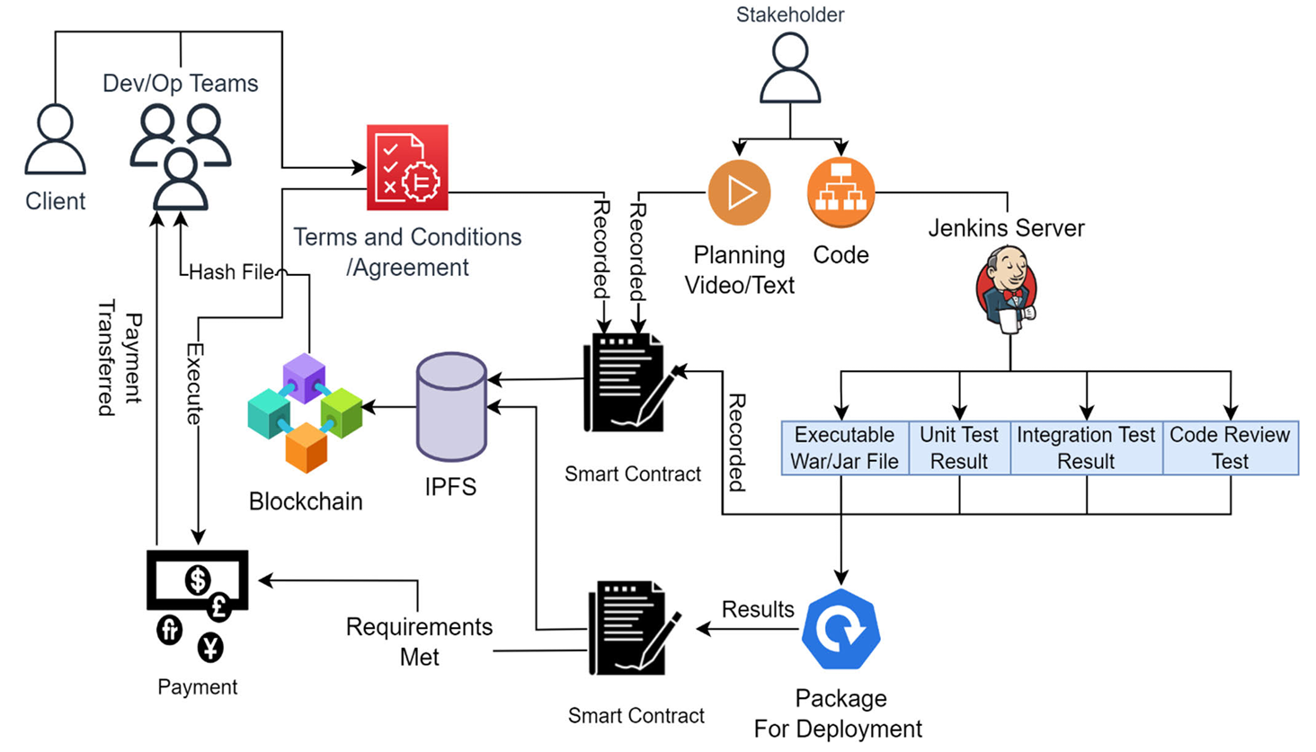
A. HIGH-LEVEL ARCHITECTURE
The high-level abstract architecture for the proposed framework is shown in Figure.
It shows the overall working of the model that will use Blockchain, an Interplanetary File System, and a Smart contract.
1️⃣
6️⃣
🔟
2️⃣
7️⃣
3️⃣
5️⃣
9️⃣
8️⃣
4️⃣

Slide 14
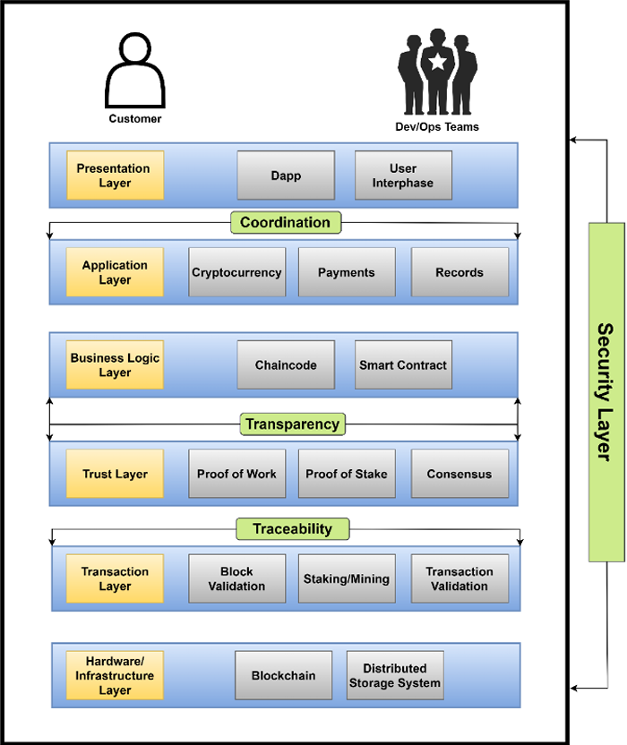
B. LAYERED ARCHITECTURE
The framework follows a blockchain-based architectural style, structured into a 7 layered architecture is shown in Figure.
Presentation Layer:- Its primary goal is to connect clients and DevOps teams to the system.

Slide 15
Application Layer:- Manages metadata (transactions, payments, agreements). Enables stakeholder communication and links the Presentation and Business Logic layers.
Business Logic Layer:- This layer Contains smart contracts defining system rules and protocols.
Trust Layer:- The Trust Layer handles consensus mechanisms (PoS, PoW) and ensures system reliability and security.

Slide 16
Transaction Layer:- The transaction layer handles transactional smart contracts, and block validation.
Hardware/Infrastructure Layer:- This layer includes the P2P network for validation and decentralized storage.
Security Layer:- The Security Layer is responsible for security measures to protect the network from potential attacks.

Slide 17
C. IMPLEMENTATION CHALLENGES AND LIMITATIONS
While the proposed framework enhances security, transparency, and traceability in distributed DevOps, it faces several implementation challenges:
Scalability Challenges:- Although IPFS support, large-scale projects with high transaction volumes may affect performance and efficiency.
IPFS Limitations:- IPFS ensures decentralized version control but lacks full Git functionality.

Slide 18
Integration Complexity:- Blockchain-DevOps integration is still evolving and may face technical failures. Effective strategies and expert collaboration are crucial for success.
Smart Contracts:- While essential for automation, smart contracts can introduce vulnerabilities if poorly designed. Thorough testing and standard practices are vital.
User Adoption And Training:- Adapting to Blockchain systems disrupts existing workflows. Training programs are necessary for smooth transition and effective use.

Slide 19
Our framework improves Distributed DevOps by ensuring decentralization, security, transparency, traceability, and better coordination.
By integrating Blockchain, it helps prevent project failures, delays, and financial losses.
Benefits include:
Decentralized and secure DevOps collaboration.
Resolution of payment issues in distributed teams.
Transparent progress tracking and improved client satisfaction.
Enhanced security and reduced conflicts.
Efficient record maintenance.
DISCUSSION

Slide 20
This research fills a gap by focusing on Distributed DevOps with a CI/CD-compatible, globally scalable solution.
Limitations include:
Risk of tech failure depending on blockchain type.
Smart contract issues may shift responsibility.
Slower data processing due to decentralization.
High implementation costs may limit adoption.
The framework offers long-term value through trust, security, and transparency.
Future work should aim to optimize performance and reduce costs for better scalability and accessibility.

Slide 21
CONCLUSION AND FUTURE WORK

Slide 22
The current Distributed DevOps model struggles with issues like security, privacy, transparency, and traceability.
The proposed framework uses smart contracts and decentralized architecture to enhance secure and efficient teamwork.
By integrating blockchain technology, it improves collaboration, transparency, traceability, and efficiency.
Future work can explore using AI/ML for automating testing, resource management, and risk prediction.
Overall, the framework is a promising step toward improving trust, security, and transparency in Distributed DevOps.

Slide 23
L. Leite, C. Rocha, F. Kon, D. Milojicic, and P. Meirelles, ‘‘A survey of DevOps concepts and challenges,’’ ACM Comput.Surv,vol. 52,no. 6, doi: https://doi.org/10.1145/3359981.
M. Gall and F. Pigni, ‘‘Taking DevOps mainstream: A critical review and conceptual framework,’’ Eur. J. Inf. Syst., vol. 31, no. 5, pp. 548–567, Sep. 2022, doi: https://doi.org/10.1080/0960085x.2021.1997100.
E. Diel, S. Marczak, and D. S. Cruzes, ‘‘Communication challenges and strategies in distributed DevOps,’’ in Proc. IEEE 11th Int. Conf. Global Softw. Eng. (ICGSE), Aug. 2016, pp. 24–28, doi: https://doi.org/10.1109/ICGSE.2016.28.
Deloitte Luxembourg. ‘‘DevOps in a Distributed World and New Ways of Working,’’ Deloitte Luxembourg, Nov. 21, 2023. [Online]. Available:https://www2.deloitte.com/lu/en/pages/risk/articles/devops-in-a-distributed-world-and-new-ways-of-working.html.
Kharnagy. ‘‘Illustration Showing Stages in a DevOps Toolchain,’’ Wikimedia Commons, 2016. Accessed: Nov. 20, 2023. [Online]. Available: https://commons.wikimedia.org/wiki/File.
REFERENCES

Slide 24
Thank you
Any Queries?

